Slide 1
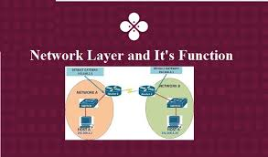
LEC -22 Network Layer

Slide 2
What is Network layer ?
It is the 3th Layer of the OSI model and from the top and the 3rd layer from the Bottom of the OSI Model.
It is one of the most important layers which plays a key role in data transmission.
The main job of this layer is to maintain the quality of the data and pass and transmit it from its source to its destination.
It also handles routing, which means that it chooses the best path to transmit the data from the source to its destination, not just transmitting the packet.

Slide 3
The main function of network layer .
Function of Network Layer.
1. It is the third layer of OSI model and it is used for transfer the packet from source to destination.
2. Network layer is used for the transmission of data from one host to the other located in different networks.
It performs two main functions.
1. First is that is breaking up segments into network packets, and second is that reassembling the packets on the receiving end.
2. Network layer also provides network addresses (typically Internet
Protocol addresses) to route packets to a destination node.

Slide 4
Network layer - IP address
Every device which is assign on the network has an IP address by which it can be uniquely identified and addressed.
An IP address is Layer-3 (Network Layer) logical address. This address may change every time a computer restarts.
A computer can have one IP at one instance of time and another IP at some different time.

Slide 5
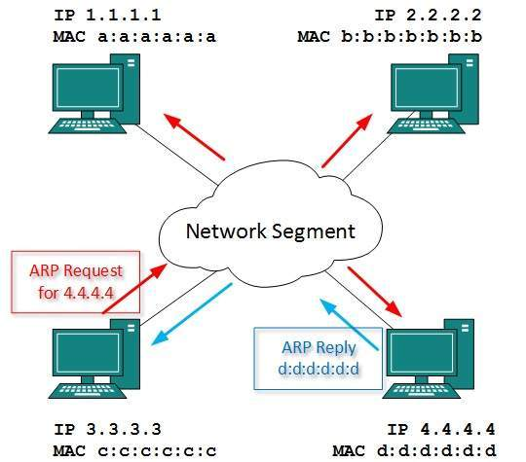
Example of devices which is assign on network uses different IP.

Slide 6
Network Layer Functions.
Some other function of network layer
Addressing - Maintains the address at the frame header of both source and destination and performs addressing to detect various devices in network .
Packeting: It is performed by Internet Protocol. The network layer converts the packets from its upper layer.
Routing: It is the most important functionality. The network layer chooses the most relevant and best path for the data transmission from source to destination.
Inter-networking: It works to deliver a logical connection across multiple devices.

Slide 7
Network Layer Design Issues.
Store-and-Forward Packet Switching.
Services Provided to the Transport Layer.
Implementation of Connectionless Service,
Implementation of Connection-Oriented Service.
Comparison of Virtual-Circuit and Datagram Subnets

Slide 8
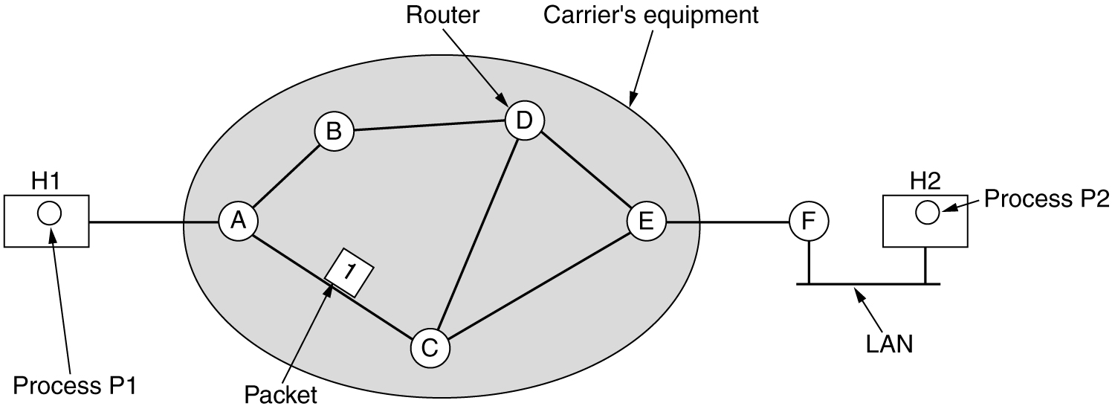
Design Issues of Network Layer.
Store-and-Forward Packet Switching - The host sends the packet to the nearest router and packet is stored there until it has fully arrived once the link is fully processed by verifying the checksum then it is forwarded to the next router till it reaches the destination. A checksum is a value that represents the number of bits in a transmission message .
Store-and-forward Packet Switching means that the packet-switched network communications whereby packet switches must receive a packet in its entirety before forwarding to the next switch in the network.

Slide 9
2. Services provided to Transport layer.
The services need to be carefully designed with the following goals in mind:-
It provides network/transport layer interface which means network layer transfers it’s services to the transport layer.
These services are described below.
But before providing these services to the transfer layer following goals must be kept in mind :-
It is Offering services must not depend on router technology.
The transport layer needs to be protected from the type, number and topology of the available router.
The network addresses for the transport layer should use uniform numbering pattern also at LAN and WAN connections.
Based on the connections there are 2 types of services provided :-
Connectionless – The routing and insertion of packets into subnet is done individually. No added setup is required.
Connection-Oriented – Subnet must offer reliable service and all the packets must be transmitted over a single route.

Slide 10
3. Implementation of Connectionless Service
Packet are termed as “datagrams” and corresponding subnet as “datagram subnets”. When the message size that has to be transmitted is 4 times the size of the packet, then the network layer divides into 4 packets and transmits each packet to router via. a few protocol.
Each data packet has destination address and is routed independently irrespective of the packets.

Slide 11
4.Implementation of Connection-Oriented Service
To use a connection-oriented service, first we establishes a connection, use it and then release it. In connection-oriented services, the data packets are delivered to the receiver in the same order in which they have been sent by the sender.
It can be done in either two ways :
Circuit Switched Connection – A dedicated physical path or a circuit is established between the communicating nodes and then data stream is transferred.
Virtual Circuit Switched Connection – The data stream is transferred over a packet switched network, in such a way that it seems to the user that there is a dedicated path from the sender to the receiver. A virtual path is established here. While, other connections may also be using the same path.

Slide 12
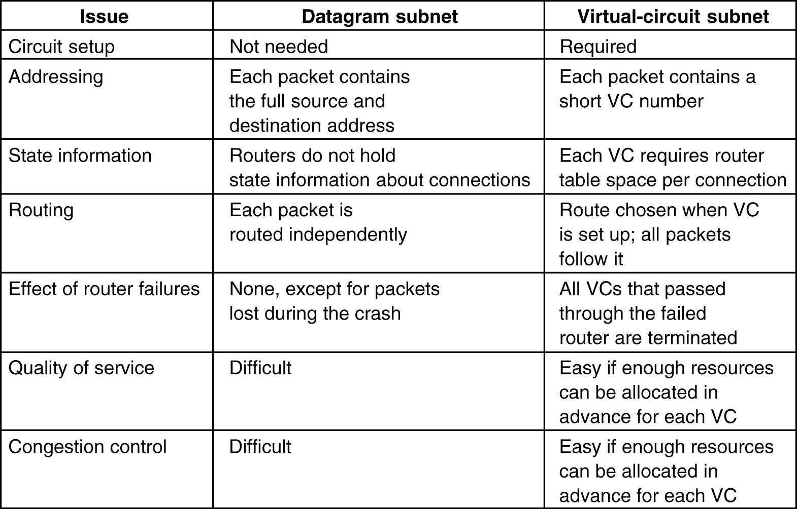
5. Comparison of Virtual-Circuit and Datagram Subnets.

Slide 13
Network Layer Services
Packetizing: encapsulating the payload(data received from upper layer) at source and decapsulating at the destination.
Routing: To find the best path from source to destination using routing protocols.
Forwarding: Action applied by each router when packet arrives at one of its interface using routing or forwarding table.
Routing and Forwarding are related to each other.

Slide 14
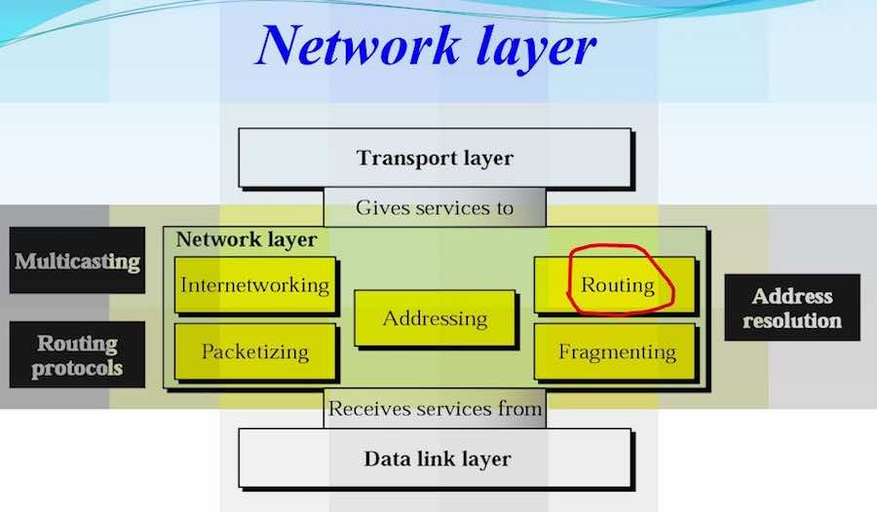

Slide 15
Configuration and addresses in a sub-netted network.

Slide 16


Slide 17
Lec – 23 Network layer Performance

Slide 18
NETWORK- LAYER PERFORMANCE .
The performance of a network can be measured in terms of:
Delay
Throughput
Packet loss

Slide 19
Delay
The delays in a network can be divided into four types:
Transmission delay
Propagation delay
Processing delay
Queuing delay.

Slide 20
Transmission Delay
Delay= (Packet length) / (Transmission rate).
Propagation Delay
Delay = (Distance) / (Propagation speed).
Processing Delay
Delay = Time required to process a packet in a router or a destination host
Queuing Delay
Delay = The time a packet waits in input and output queues in a router
Total Delay
Total delay = (n + 1) (Delaytr + Delaypg + Delaypr) + (n) (Delayqu)

Slide 21
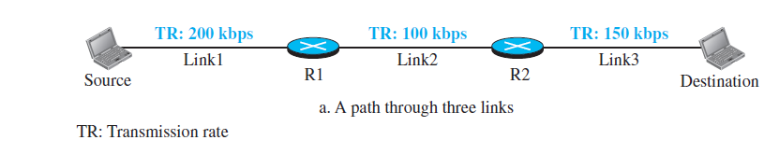
Throughput
Throughput = minimum {TR1, TR2, . . . TRn}.

Slide 22
Packet Loss
When a router receives a packet while processing another packet, the received packet needs to be stored in the input buffer waiting for its turn.
A router, however, has an input buffer with a limited size. A time may come when the buffer is full and the next packet needs to be dropped.
The effect of packet loss on the Internet network layer is that the packet needs to be resent, which in turn may create overflow and cause more packet loss.

Slide 23
Addressing perform in network layer both classful and classless .
Classful Addressing - In the IPv4 addressing the concept of classes is used for giving IP addressing . This architecture is known as classful addressing.
In the classful addressing, there are 5 classes in which the address space is divided: A, B, C, D, and E. There are five types of classes .
Class A
Class B
Class C
Class D
Class E

Slide 24
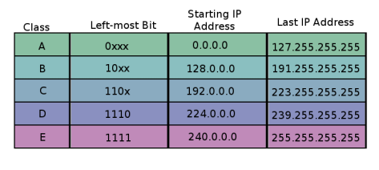
Different IP Classes Ranges.

Slide 25
Three-level hierarchy in an IPv4 address.

Slide 26
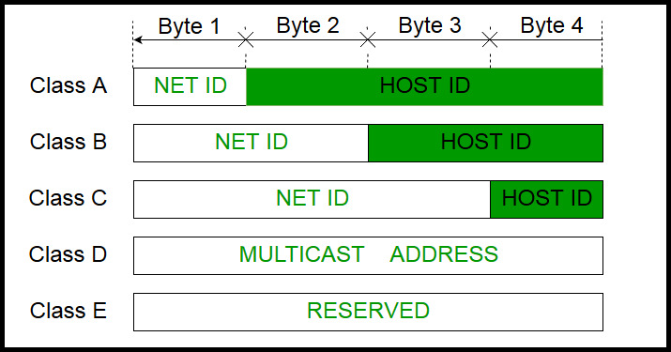
What is network ID and host ID?
The class of IP address is used to determine the bits used for network ID and host ID and the number of total networks and hosts possible in that particular class. Each ISP or network administrator assigns an IP address to each device that is connected to its network.

Slide 27
Classless Addressing
Classless addressing is also know as Classless Inter-Domain Routing (CIDR). In the classless addressing type helps to allocate IP addresses more efficiently. When the user requires a particular number of IP addresses, this method assigns a block of IP addresses concerning certain rules. And, this block is called a CIDR block and has the required number of IP addresses.
A classless addressing system or classless interdomain routing (CIDR) was developed to alternative traditional subnetting. We can add the specification in the IP(Internet Protocol) address itself as to the number of significant bits that make up the networking portion.

Slide 28
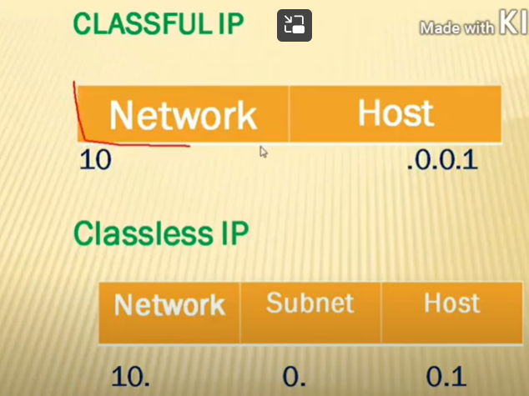
Example of classful IP and Classless IP.

Slide 29
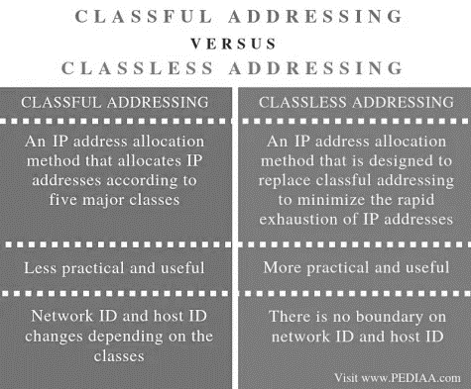
Difference Between Classful and classless addressing .

Slide 30
What is Packet Forwarding?
Packet Forwarding means forwarding of incoming packets to their intended destination.
In the packet Forwarding same network is associated with as the source host or may belong to a destination host in a different network.
In the packet forwarding router is responsible for the process of forwarding the packet . It accepts the packet from the origin host or another router in the packet’s path and places it on the route leading to the target host.

Slide 31
Example of packet Forwarding .
In the packet forwarding routers are used to forward the packet from the local network to the remote network. So, the process of routing involves the packet forwarding from an entry interface out to an exit interface.

Slide 32
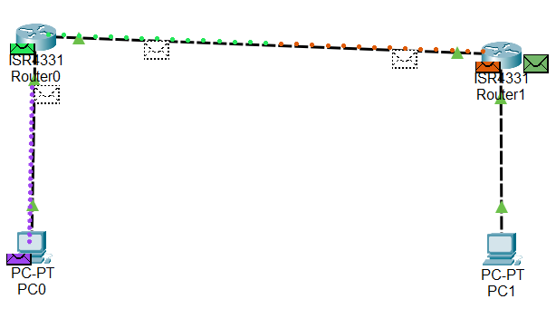
Message is send from source router to destination router .

